Slide 1
Polynomial Regression Explained for beginners
What is Polynomial Regression ?
Theory of Polynomial Regression
Polynomial vs Linear
Let’s do some hands-on in Python
Sajjad Mustafa

Slide 2
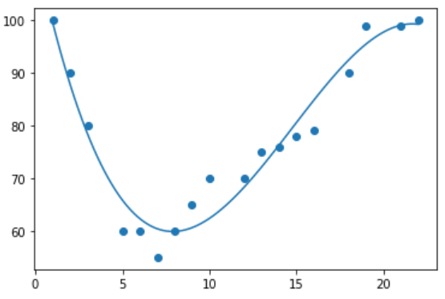
Polynomial Regression

Slide 3
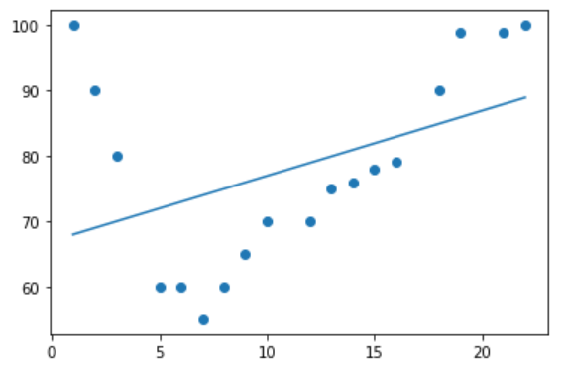
Polynomial vs Linear

Slide 4
Prediction

Slide 5
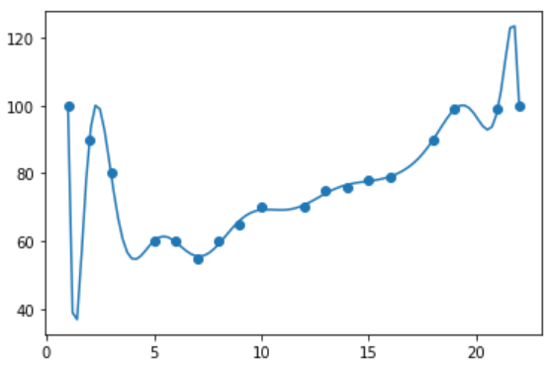
Overfitting

Slide 6
Underfitting

Slide 7
Website : www.aisciences.io

